Slide 1
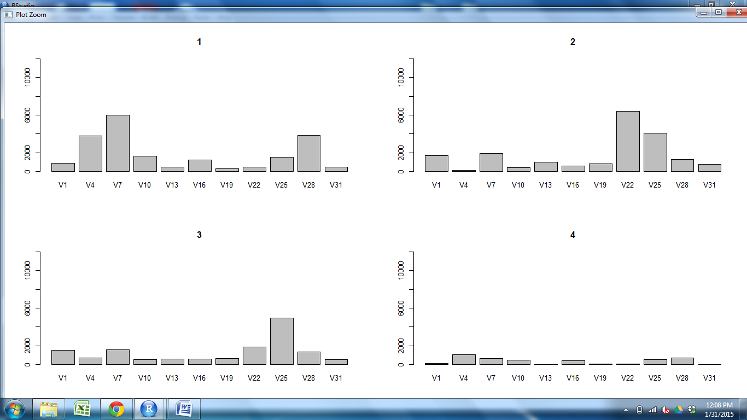
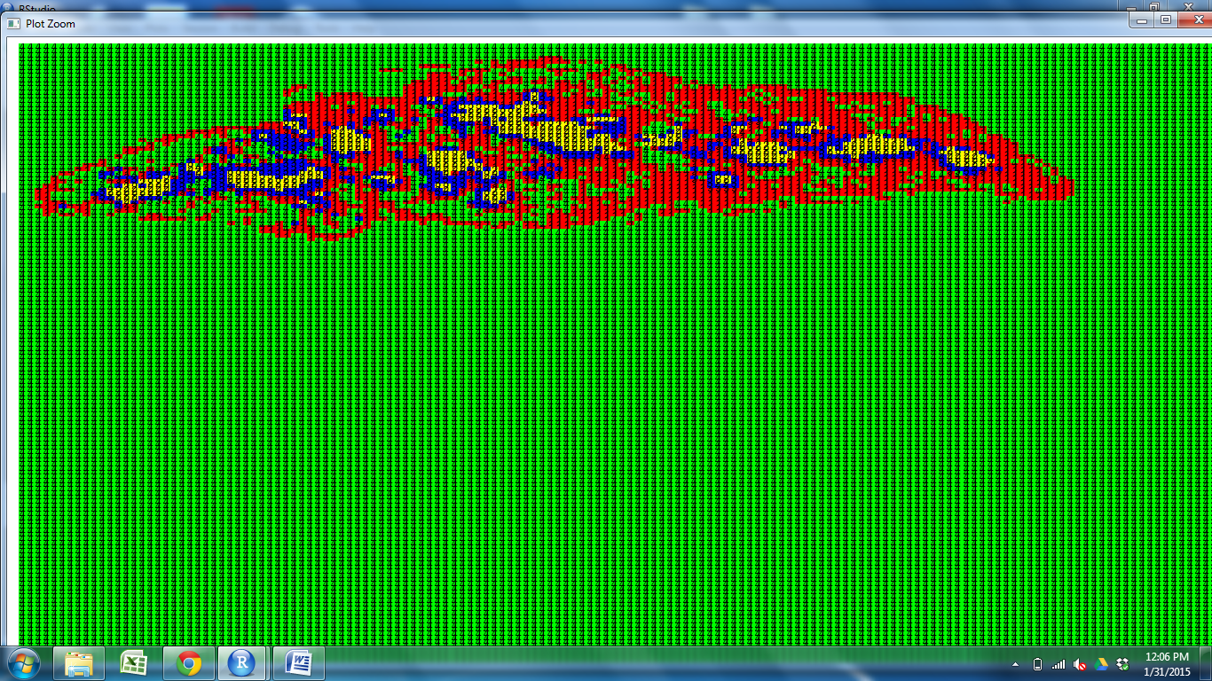
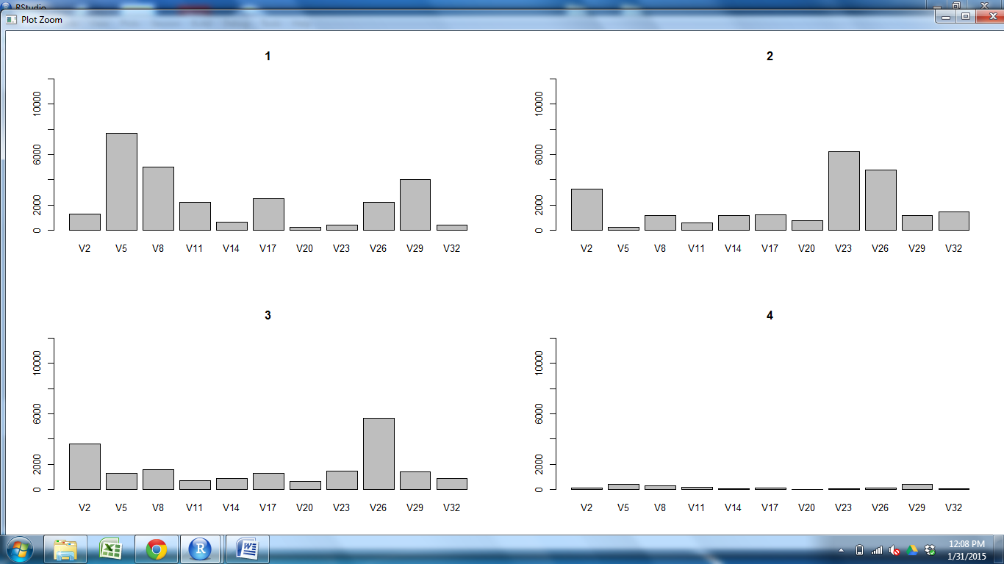
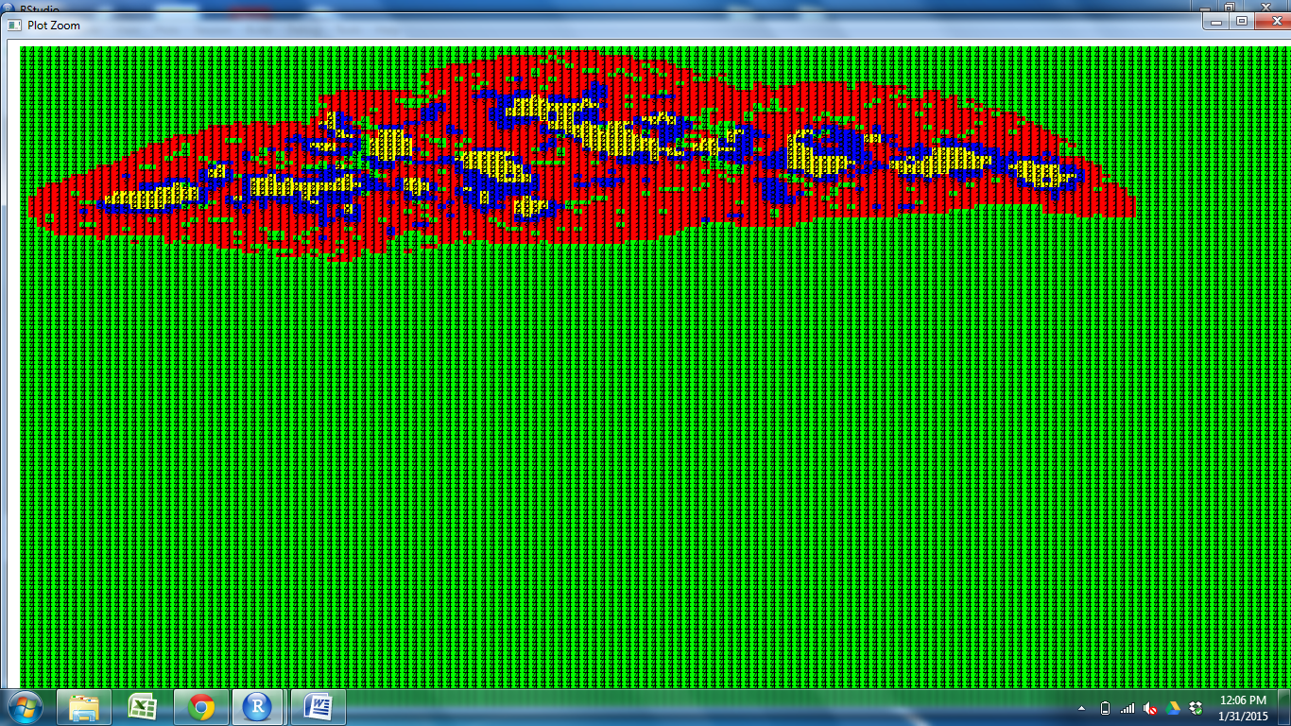
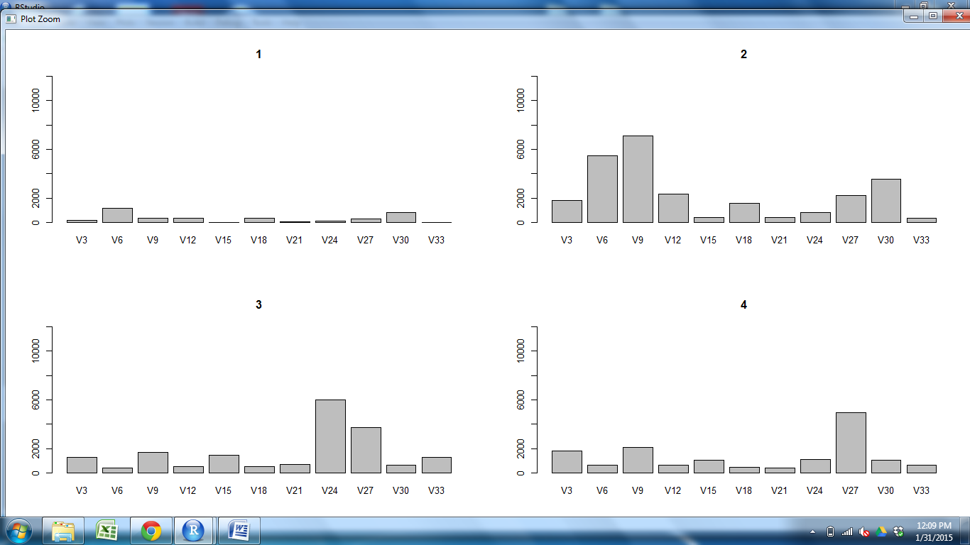
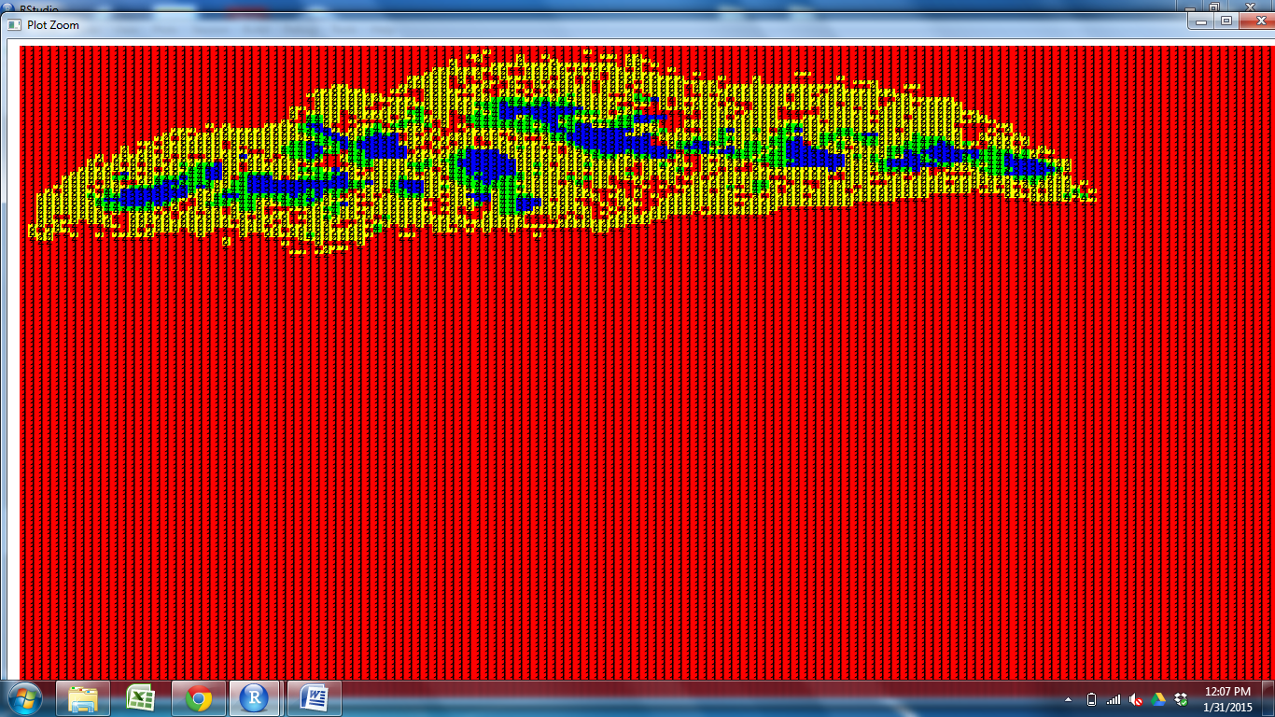
CD11c CD205 CD25 CD31 Claud34 Claud5 Foxp3 K14 K5 PDGFRb UEA1

Slide 2
CD11c CD205 CD25 CD31 Claud34 Claud5 Foxp3 K14 K5 PDGFRb UEA1

Slide 3
CD11c CD205 CD25 CD31 Claud34 Claud5 Foxp3 K14 K5 PDGFRb UEA1

Slide 4
CD11c CD205 CD25 CD31 Claud34 Claud5 Foxp3 K14 K5 PDGFRb UEA1

Slide 5
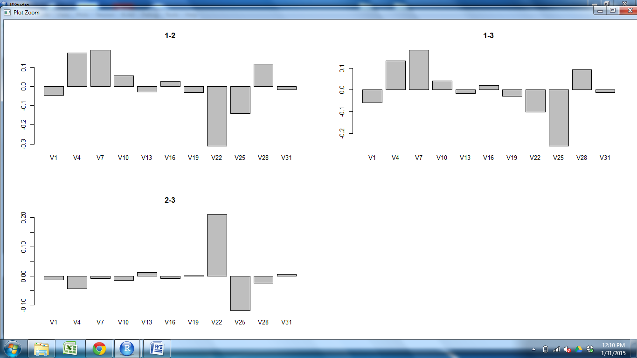
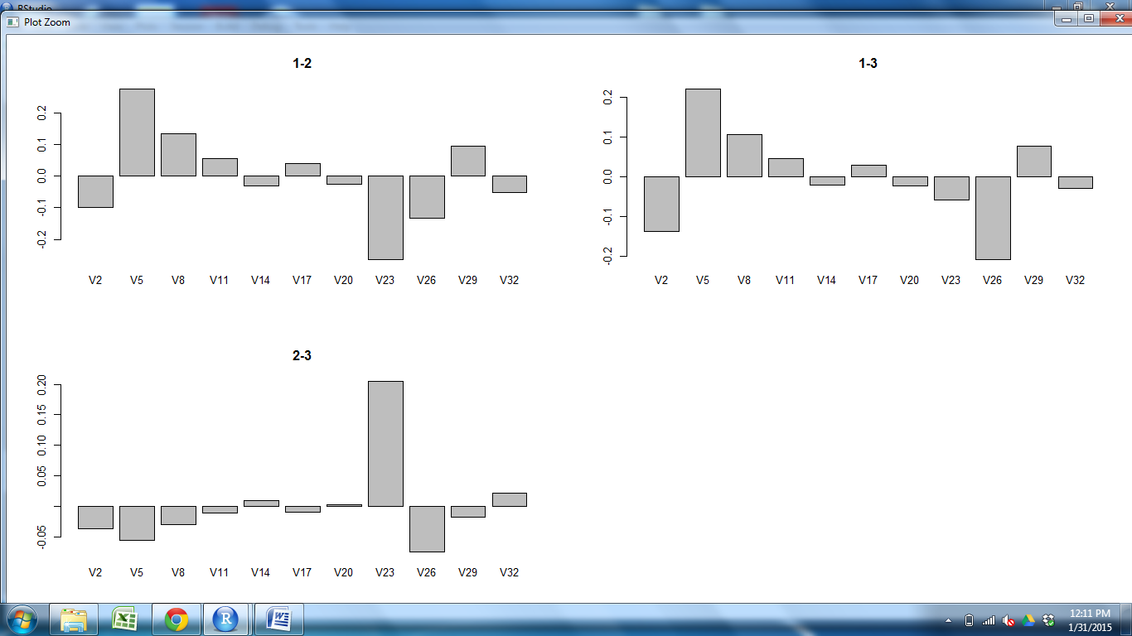
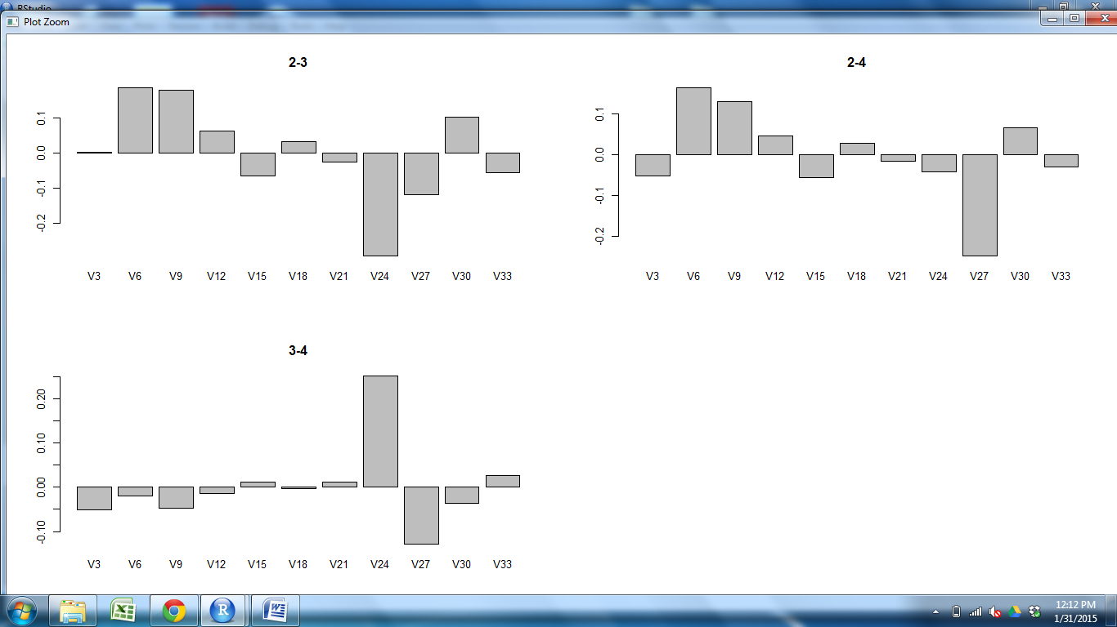
CD11c CD205 CD25 CD31 Claud34 Claud5 Foxp3 K14 K5 PDGFRb UEA1

Slide 6
CD11c CD205 CD25 CD31 Claud34 Claud5 Foxp3 K14 K5 PDGFRb UEA1

Slide 7
CD11c CD205 CD25 CD31 Claud34 Claud5 Foxp3 K14 K5 PDGFRb UEA1

Slide 8
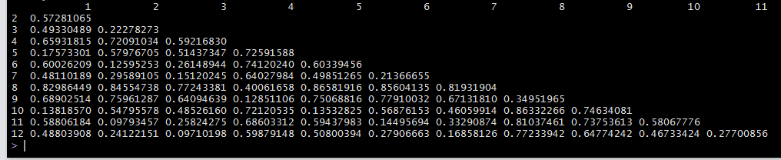
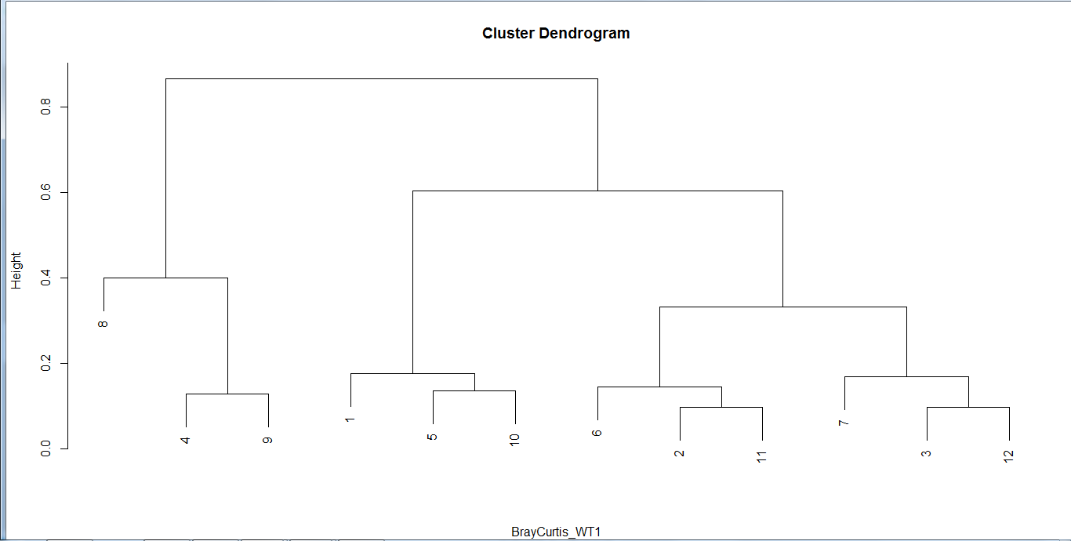
Cortex M2 M1 Outer Cortex M2 M1 Outer Outer Cortex M2
M2
M1
Outer
Cortex
M2
M1
Outer
Outer
Cortex
M2
M1
S2Outer S1Outer S3Outer S1Cortex S2Cortex S3Cortex S2M2 S1M2 S3M2 S2M1 S1M1 S3M1

